Slide 1
SOFTWARE DEVELOPMENT
Dynamic dependency monitoring systems

Slide 2
Company Overview
The Target company is Cisco Systems.
Cisco Systems, Inc. is an American multinational company headquartered in San Jose, California.
This company manufactures and sells telecommunications equipment, high-tech products & services, and networking hardware.
Further, it focuses on technology markets like domain security, energy management, and internet of things [1].
Notes:
Cisco Systems is a multinational American company which majors in manufacture and sell of telecommunications equipment, high-tech products & services, and networking hardware.

Slide 3
Project Overview
Computer science students working with Cisco Systems to develop a software.
The main idea is to extend the run-time information flow monitoring
To support the increasing information flow in the systems and customer information.
A main issue addressed is the flow of customer information and personal needs of the customers.
Issues related to information security and on-time feedback were also addressed.
Notes:
This project is done by computer students with the aim of developing a software which can be used to monitor customer information in real time.

Slide 4
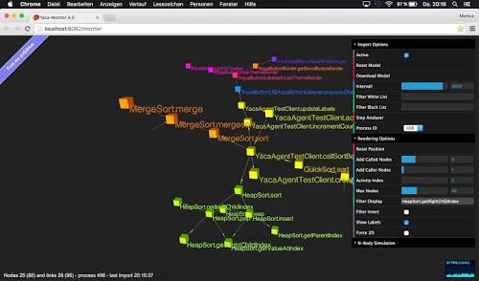
Project Overview
Also, insecure executions within the program will be addressed to ensure that there an entire program is not rejected in case of wrong executions, but provides the exact area where changes should be done.

Slide 5
Overview of Run-time information flow monitoring
This is potentially more effective compared to a static monitoring system. This is because the program rejects only wrong executions within a program as opposed to static which rejects an entire program [2].
It can be used with dynamic languages such as JavaScript and Pearl [2].
It supports dynamic security policies.
Notes:
Run-time information flow monitoring is beneficial compared to other information monitoring systems. It does not reject a whole program but rather rejects the part where wrong executions are done.
Also, it supports dynamic languages and security policies.

Slide 6
Obstacles
Budgetary risks
Industry & Market risks
Change of requirements
Skills for each unique demands of the project
Integrating different technologies.
Technical challenges
Notes:
Through this project, different challenges were met including Budget, industry and market risks, technical challenges, integration of different technologies, and changes of requirements.

Slide 7
SDLC Considerations
Initiation phase
Development phase
Implementation phase
Operations phase
Disposal phase

Slide 8
software
Different software technologies will be used in order to achieve the goals of the project. These can include;
Spreadsheet software and word processing software
Information tracking toolkit
Dynamic monitoring system
Spyware programs
MemCache
Notes:
In order to achieve the goal of the software development project, several software will be used including MemCache, spyware programs, dynamic monitoring system, information tracking toolkit, and spreadsheet and word processing software.

Slide 9
Software development techniques
Dynamic systems development model (DSDM)
Pre-project (feasibility and foundations)
Exploration
Engineering
Incremental deployment
Notes:
The DSDM is a project delivery framework used for software development.

Slide 10
Advantages of Dynamic Systems Development Model (DSDM).
Strong foundation of governance
Allows continuous user involvement
It fixes cost, time, and quality at onset.
Notes:
It has a strong foundation of governance allowing it to be governed effectively.
It aslo allows users to monitor their activities continuously without omitting any process.
Also, it is a cheap software which can be used for different uses allowing users to enjoy quality at fixed costs.

Slide 11
Works cited
[1]. Cisco Systems, Inc. (2013). 2012 Annual Report Form 10-K. [accessed 7/30/2018]
[2]. Shroff, P., Smith. S., and Thober. M. (2007). Dynamic Dependency Monitoring to Secure Information Flow. IEEE Xplore. Doi: 10.1109/CSF.2007.20

